Slide 1
Music Listener
Segmentation
Week 4 unsupervised learning and model tuning project
Name- Prayas Palit
Institute- National Institute of Technology, Sikkim
GNPICIL
Goal
Final result: 8 taste segments
Use play counts to create listener taste segments with t-SNE, K-Means, and silhouette evaluation.
1

Slide 2
Project topic checklist
This slide matches the Music Listener Segmentation topic row.
Requirement
Implemented in project
Project Title
Music Listener Segmentation
Domain
MusicTech
Data Type
Play counts
Preprocessing
Normalize and rank
Dimensionality Reduction
t-SNE
Clustering Method
K-Means
Evaluation Metric
Silhouette score
Final Output
Music taste segments
Tools
Python, pandas, scikit-learn, TSNE, KMeans, seaborn, matplotlib, plotly
2

Slide 3
Analysis coverage
The project includes the required data checks, modeling steps, visuals, and outputs.
Analysis item
Project implementation
Summary statistics
Added table in notebook and PPT
Pair plots and heatmaps
Pair plot plus numeric heatmap
Outlier detection
Boxplot using log play counts
Dimensionality reduction
PCA variance check plus t-SNE
Core clustering
K-Means final model
Model tuning
Elbow, silhouette, GridSearchCV
Extra evaluation
Davies-Bouldin score
Visualization
t-SNE clusters, centroids, dendrogram
Insights/reporting
Segment labels, CSV outputs, PPT report
3

Slide 4
Project workflow
The work moves from problem understanding to reporting in a clear sequence.
Phase 1
Phase 2
Phase 3
Problem
Data
EDA
Group listeners by music taste.
Last.fm user-artist play counts.
Stats, pair plot, heatmap, outliers.
Phase 4
Phase 5
Phase 6
Clustering
Tuning
Visuals
t-SNE plus K-Means.
Elbow, silhouette, GridSearchCV.
Clusters, centroids, dendrogram.
Dataset: 1381 listeners, 12 selected top artists.
Best params: n_clusters = 8, init = random; silhouette = 0.525; Davies-Bouldin = 0.657.
4

Slide 5
Summary statistics
This step helps understand spread before clustering.
Artist
Mean
Std
Median
Max
Britney Spears
1732.9
7819.3
0.0
131733
Depeche Mode
942.3
10850.6
0.0
352698
Lady Gaga
935.1
4467.6
0.0
114672
Christina Aguilera
766.4
5645.1
0.0
176133
Paramore
697.6
7138.3
0.0
227829
Madonna
667.1
3013.5
0.0
41216
Rihanna
655.6
3083.6
0.0
43864
Shakira
498.6
6751.5
0.0
172496
Interpretation: high max values show that some listeners play a few artists much more than others, so normalization is needed.
5

Slide 6
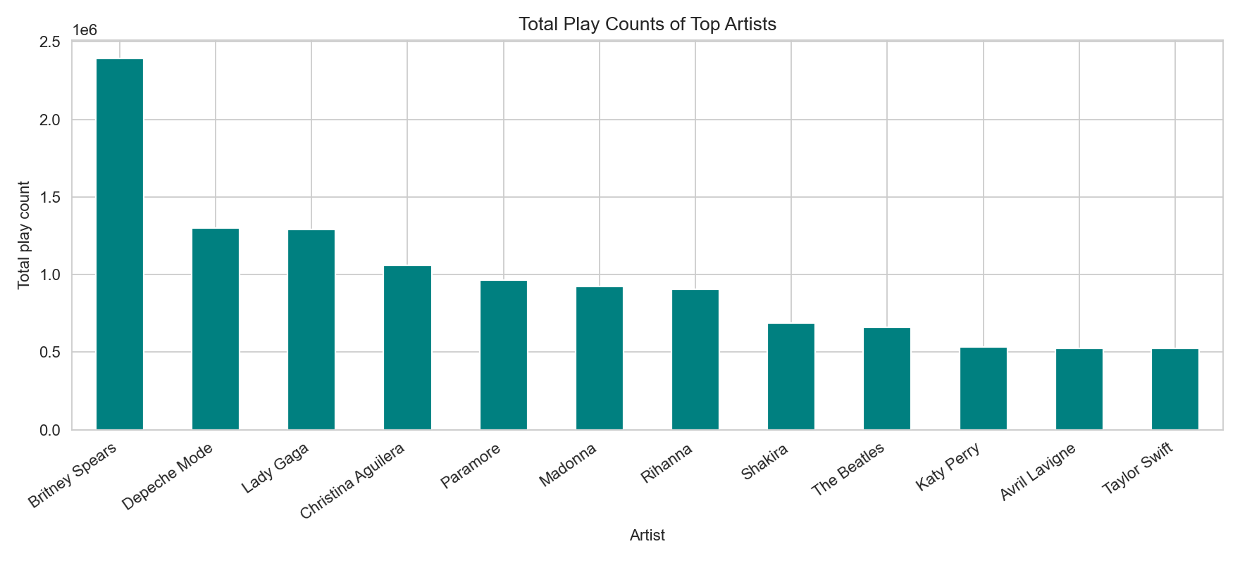
Graph 1: Total play counts
EDA
What it shows
It ranks the selected artists by total play count.
Why it matters
This explains why these artists were used as clustering features.
6

Slide 7
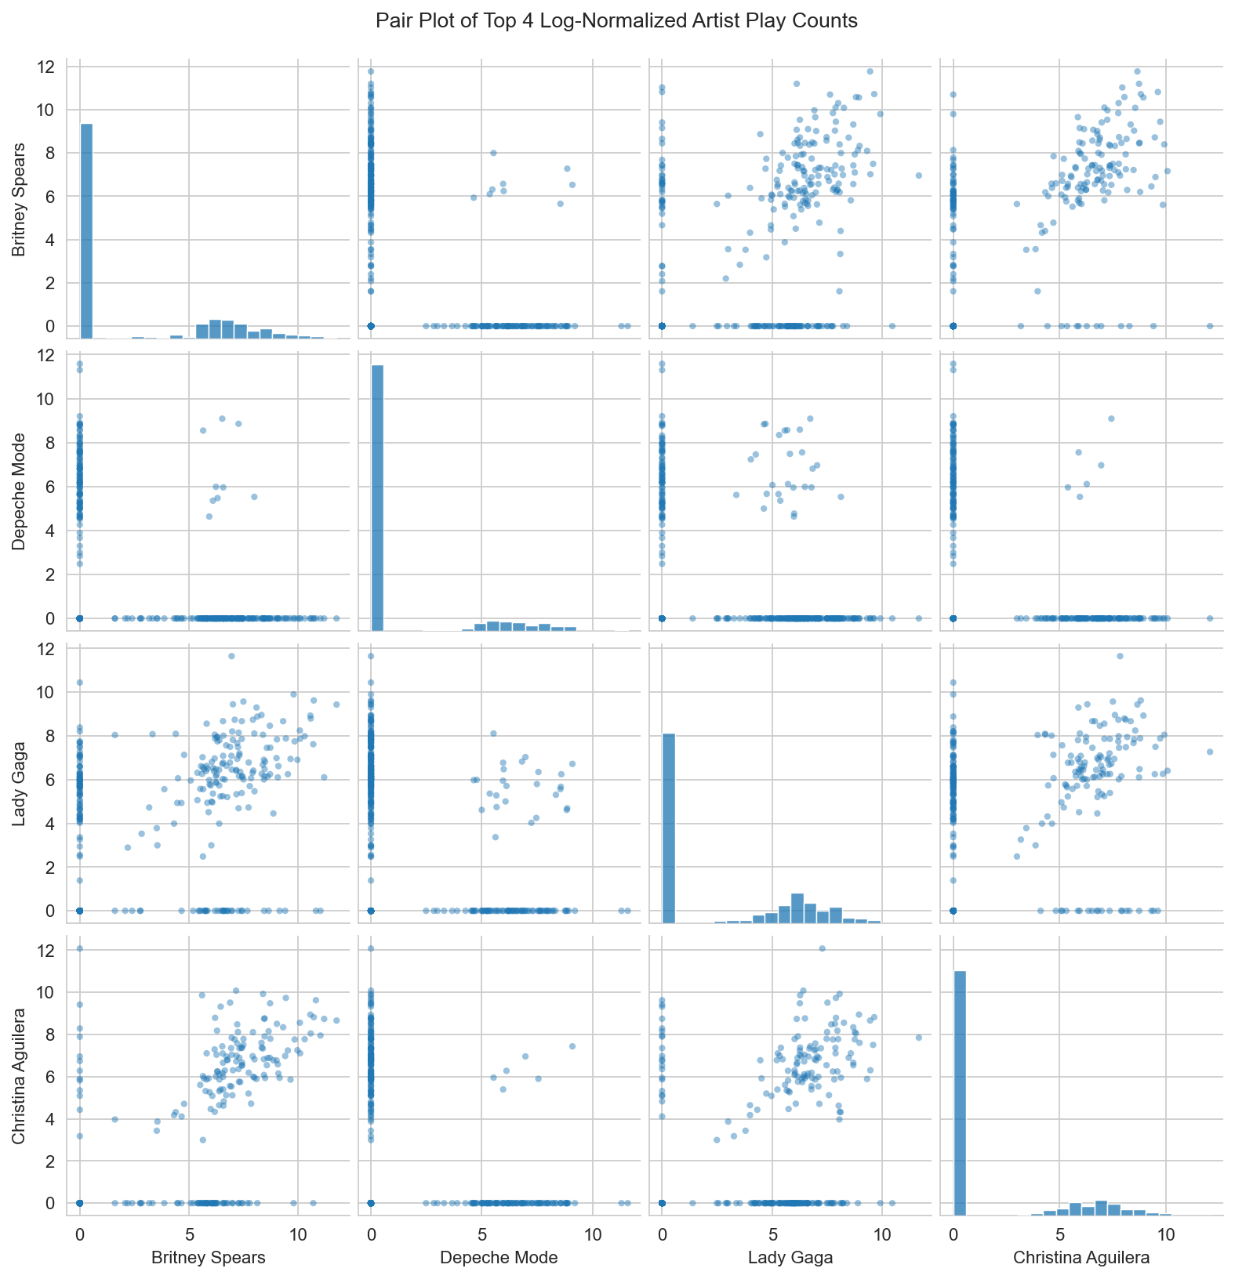
Graph 2: Pair plot
EDA
What it shows
It compares the first four log-normalized artist play-count features against each other.
Why it matters
Pair plots help inspect feature distributions and relationships before clustering.
7

Slide 8
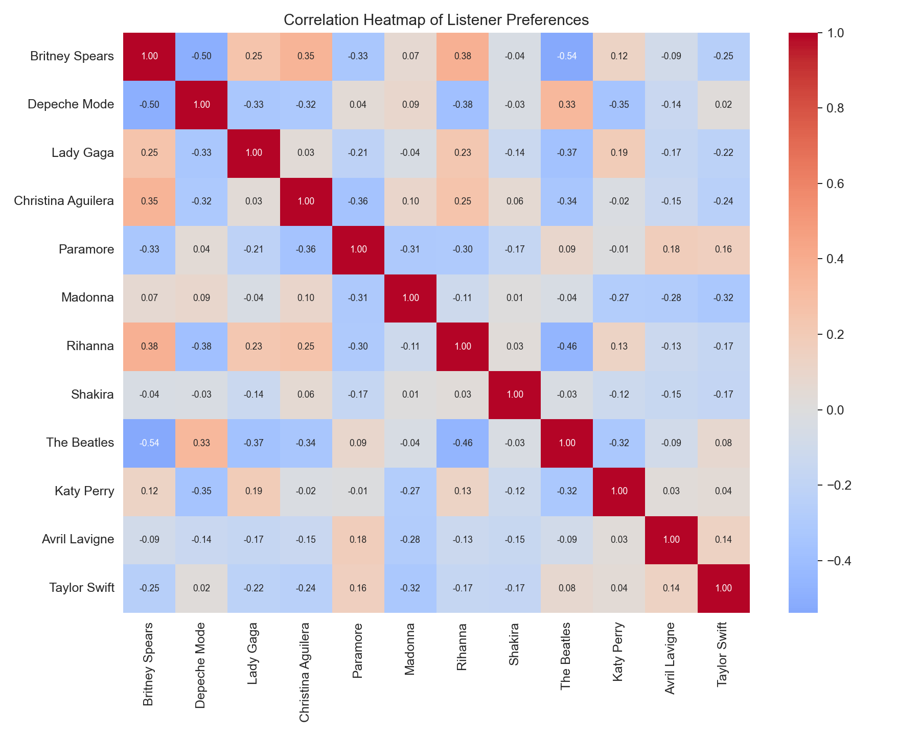
Graph 3: Numeric heatmap
EDA
What it shows
It shows correlation values inside the heatmap cells.
Why it matters
The numbers make the relationship strength clear instead of relying only on color.
8

Slide 9
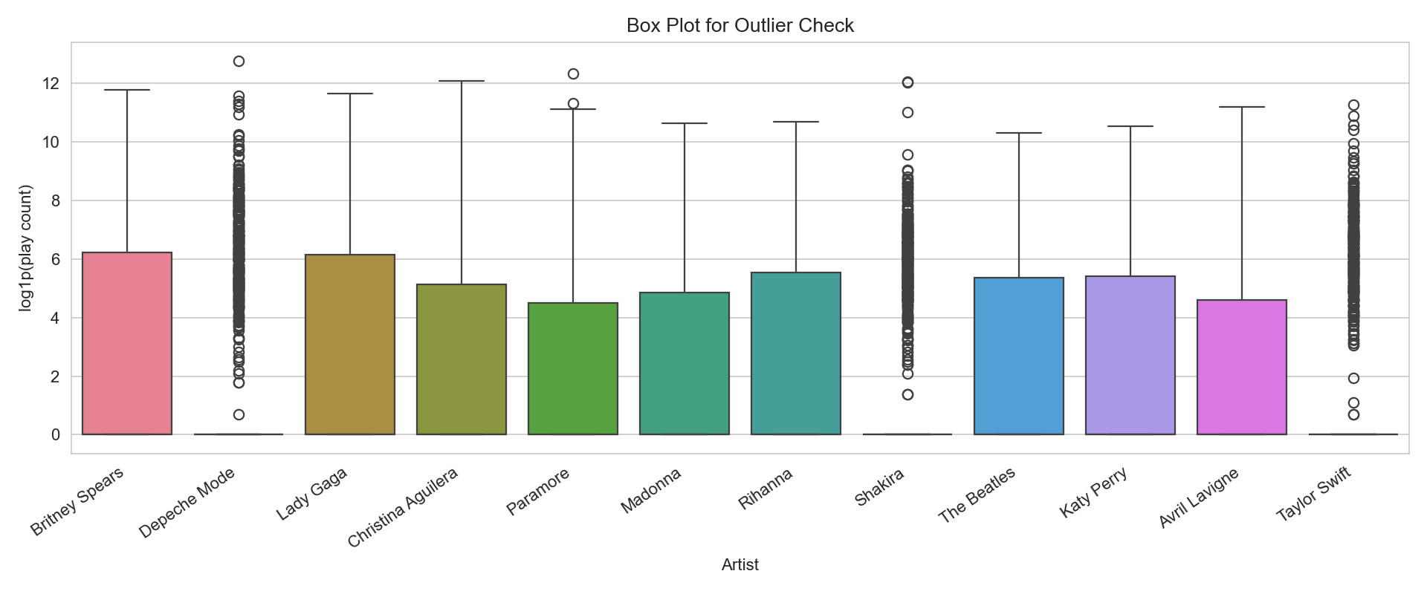
Graph 4: Outlier boxplot
EDA
What it shows
It shows spread and possible outliers after log normalization.
Why it matters
This checks whether very high play counts could dominate clustering.
9

Slide 10
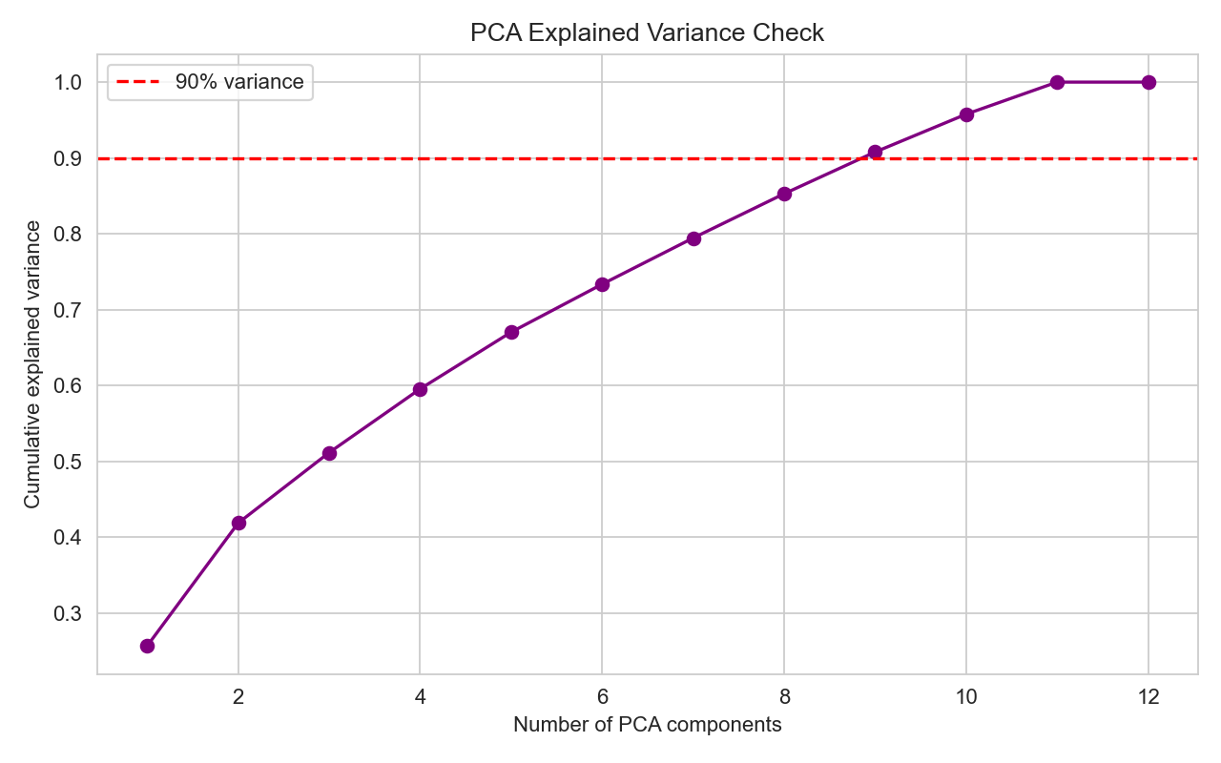
Graph 5: PCA variance check
Dimensionality reduction
What it shows
It shows how much variance is retained as components increase.
Why it matters
PCA helps check whether many features can be represented with fewer components.
10

Slide 11
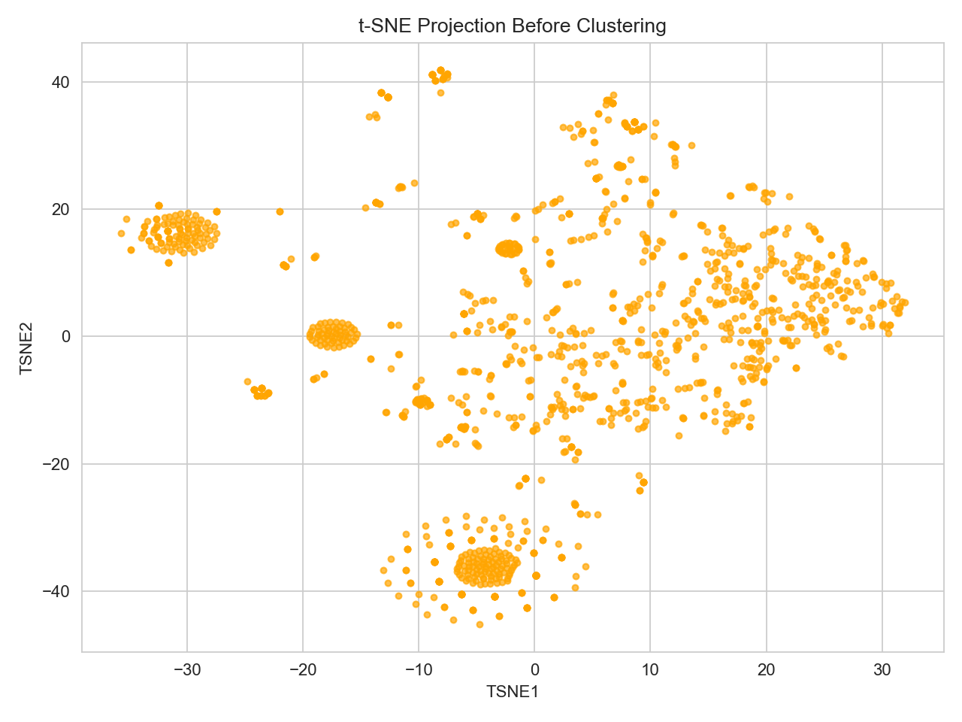
Graph 6: t-SNE projection
Dimensionality reduction
What it shows
It maps 12 artist features into 2D.
Why it matters
This makes hidden listener patterns visible before K-Means.
11

Slide 12
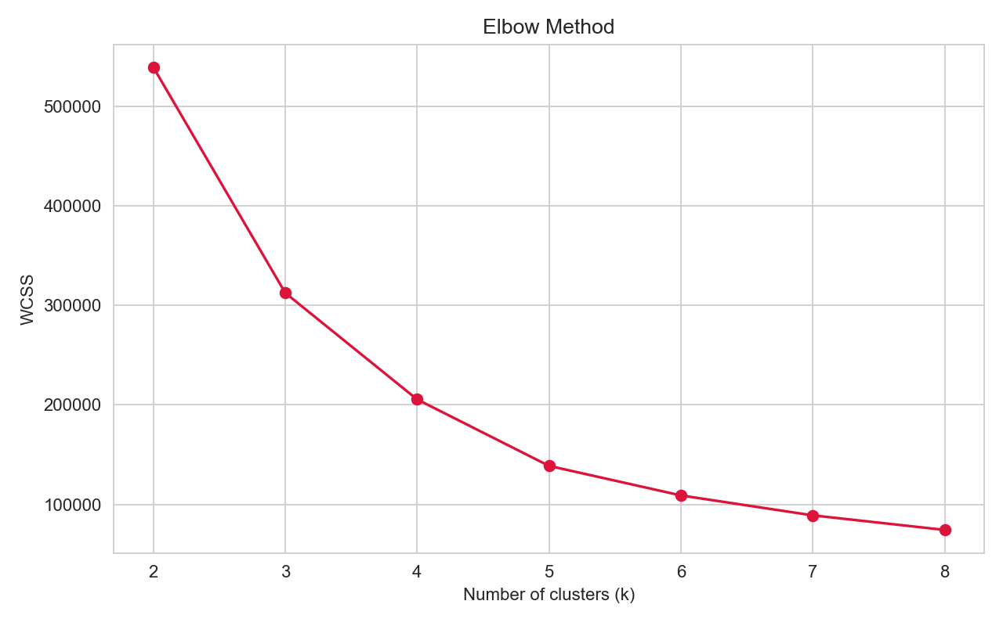
Graph 7: Elbow method
Model tuning
What it shows
It shows WCSS for different K values.
Why it matters
It helps choose clusters without blindly guessing K.
12

Slide 13
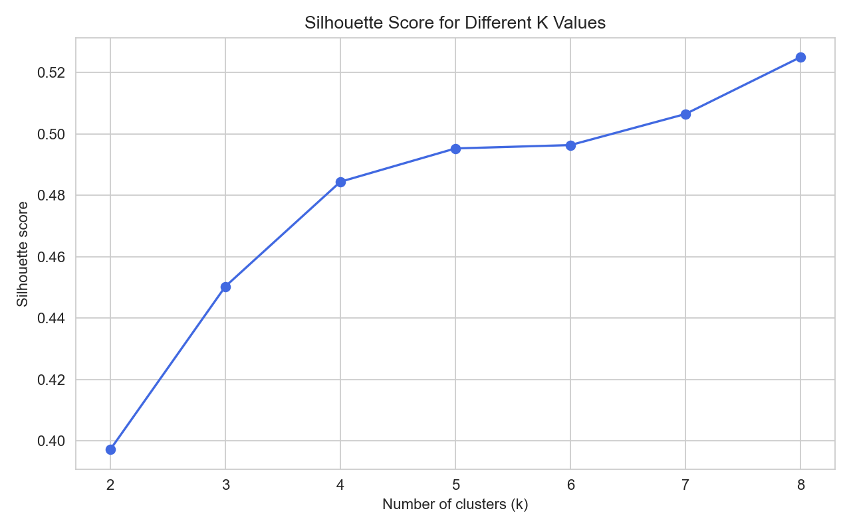
Graph 8: Silhouette score
Evaluation
What it shows
It compares cluster quality for each K.
Why it matters
The best model used K = 8, final silhouette 0.525.
13

Slide 14
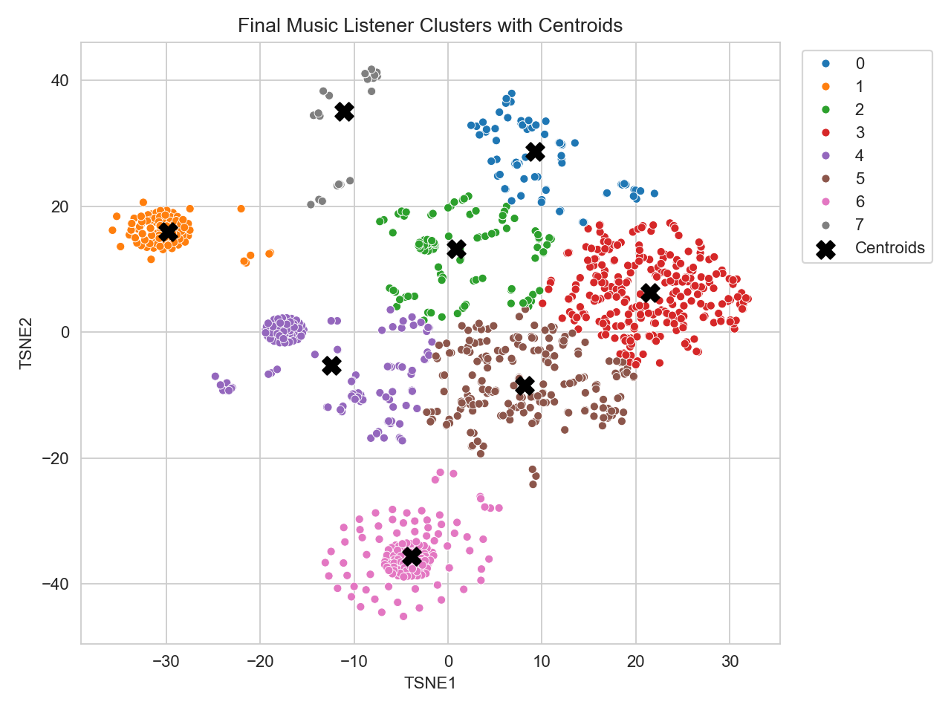
Graph 9: Final clusters with centroids
Visualization
What it shows
Colors show K-Means groups and black X markers show centroids.
Why it matters
The centroids show the center position of each K-Means group.
14

Slide 15
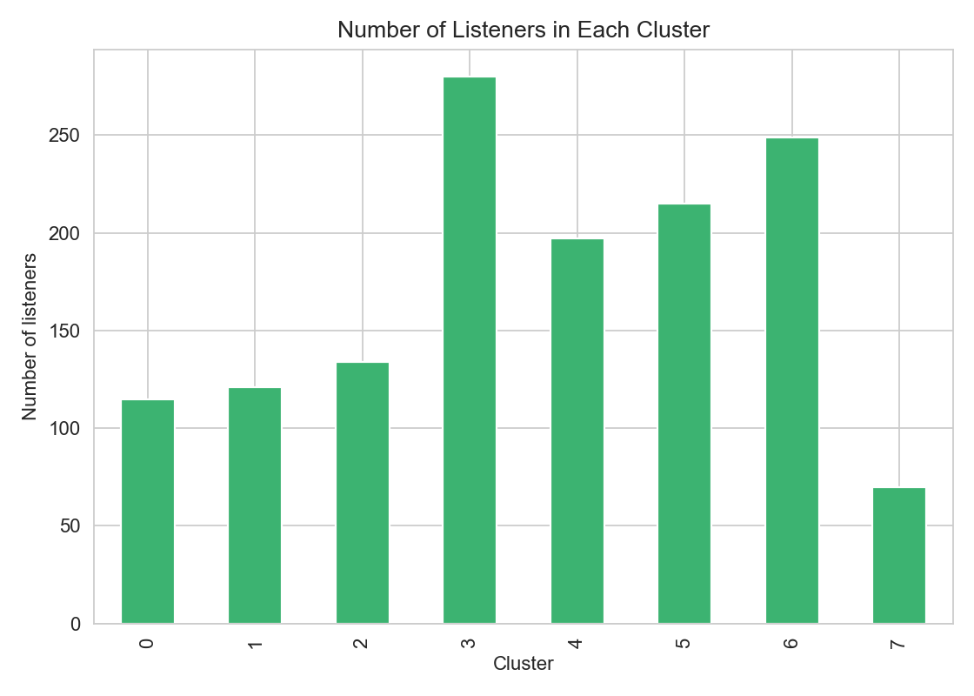
Graph 10: Cluster sizes
Reporting
What it shows
It counts how many listeners are in each segment.
Why it matters
This checks whether the segments are practical and not extremely imbalanced.
15

Slide 16
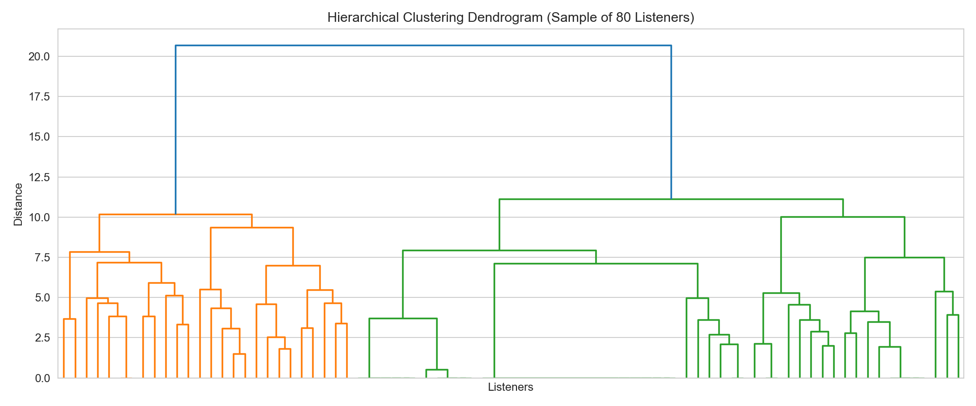
Graph 11: Dendrogram
Hierarchical clustering view
What it shows
It shows a hierarchical clustering view on a readable listener sample.
Why it matters
This adds a second view of how listeners can be grouped by similarity.
16

Slide 17
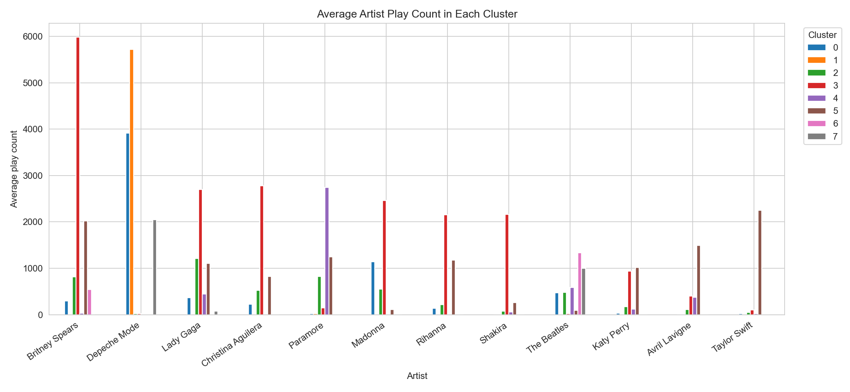
Graph 12: Cluster profiles
Insights
What it shows
It compares average artist play counts inside each cluster.
Why it matters
The highest artists in each cluster are used to name taste segments.
17

Slide 18
Final music taste segments
Final output required by the project topic.
Cluster
Music Taste Segment
Listeners
C0
Depeche Mode / Madonna listeners
115
C1
Depeche Mode / Paramore listeners
121
C2
Lady Gaga / Paramore listeners
134
C3
Britney Spears / Christina Aguilera listeners
280
C4
Paramore / The Beatles listeners
197
C5
Taylor Swift / Britney Spears listeners
215
C6
The Beatles / Britney Spears listeners
249
C7
Depeche Mode / The Beatles listeners
70
Interpretation: clusters are named using the top average artist preferences in each group.
18

Slide 19
Conclusion
The project now covers the topic requirements and the broader analysis workflow.
What changed
Final files
1. Heatmap has numbers
2. Pair plot shows log-normalized play counts
3. PCA, GridSearchCV, and DB score are included
4. Centroids and dendrogram are included
5. Segment summary CSV is saved
Music_Listener_Segmentation_WEEK4.ipynb
Music_Listener_Segmentation_WEEK4_clean.pptx
music_listener_segment_summary.csv
Saved in E:/GNPICIL/WEEK 4
19

